Slide 1
Scalar and Vector Projections

Slide 2

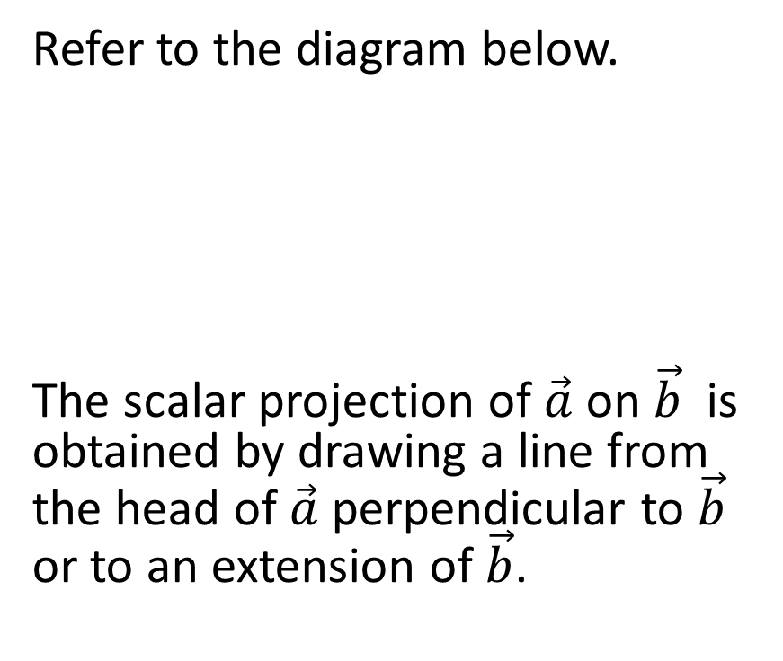

Part 1: Scalar Projections
Refer to the diagram below.
The scalar projection of $\vec{a}$ on $\vec{b}$ is obtained by drawing a line from the head of $\vec{a}$ perpendicular to $\vec{b}$ or to an extension of $\vec{b}$.
$$\vec{a}$$
$$\vec{b}$$

Slide 3



Refer to the diagram below.
The scalar projection of $\vec{a}$ on $\vec{b}$ is obtained by drawing a line from the head of $\vec{a}$ perpendicular to $\vec{b}$ or to an extension of $\vec{b}$.
Suppose $\vec{b}$ is seemingly not long enough
$$\vec{a}$$
$$\vec{a}$$
$$\vec{b}$$
$$\vec{b}$$

Slide 4
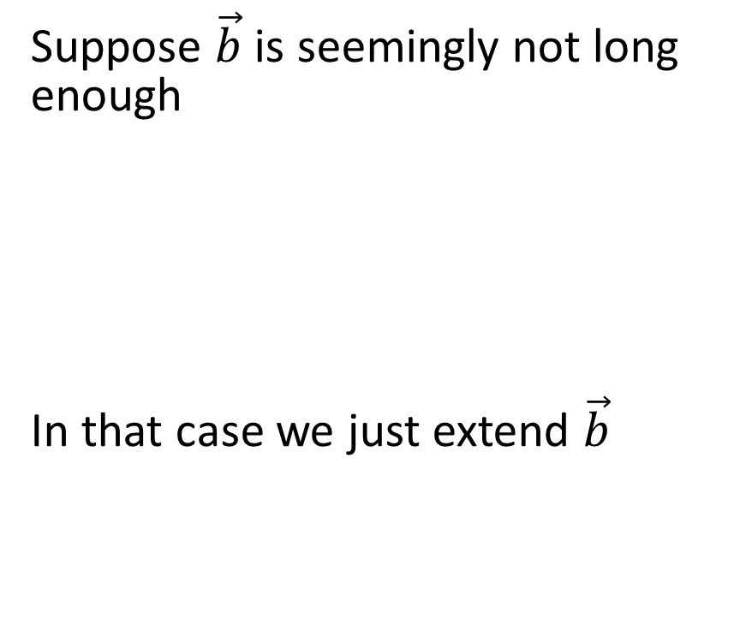
Refer to the diagram below.
The scalar projection of $\vec{a}$ on $\vec{b}$ is obtained by drawing a line from the head of $\vec{a}$ perpendicular to $\vec{b}$ or to an extension of $\vec{b}$.
Suppose $\vec{b}$ is seemingly not long enough
In that case we just extend $\vec{b}$
$$\vec{a}$$
$$\vec{a}$$
$$\vec{b}$$
$$\vec{b}$$

Slide 5
Refer to the diagram below.
The scalar projection of $\vec{a}$ on $\vec{b}$ is obtained by drawing a line from the head of $\vec{a}$ perpendicular to $\vec{b}$ or to an extension of $\vec{b}$.
Suppose $\vec{b}$ is seemingly not long enough
In that case we just extend $\vec{b}$
$$\vec{a}$$
$$\vec{a}$$
$$\vec{b}$$
$$\vec{b}$$

Slide 6
Refer to the diagram below.
The scalar projection of $\vec{a}$ on $\vec{b}$ is obtained by drawing a line from the head of $\vec{a}$ perpendicular to $\vec{b}$ or to an extension of $\vec{b}$.
Suppose $\vec{b}$ is seemingly not long enough
In that case we just extend $\vec{b}$
$$\vec{a}$$
$$\vec{a}$$
$$\vec{b}$$
$$\vec{b}$$

Slide 7


$$\vec{a}$$
$$\vec{a}$$
$$\vec{b}$$
$$\vec{b}$$

Slide 8




$$\vec{a}$$
$$\vec{a}$$
$$\vec{b}$$
$$\vec{b}$$

Slide 9
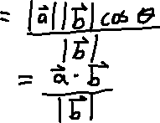


$$\vec{a}$$
$$\vec{a}$$
$$\vec{b}$$
$$\vec{b}$$

Slide 10


But what if the angle is obtuse?
$$\vec{a}$$
$$\vec{b}$$

Slide 11

But what if the angle is obtuse?
In this case, we just extend $\vec{b}$ in its opposite direction.
$$\vec{a}$$
$$\vec{b}$$

Slide 12
But what if the angle is obtuse?
In this case, we just extend $\vec{b}$ in its opposite direction.
$$\vec{a}$$
$$\vec{b}$$

Slide 13

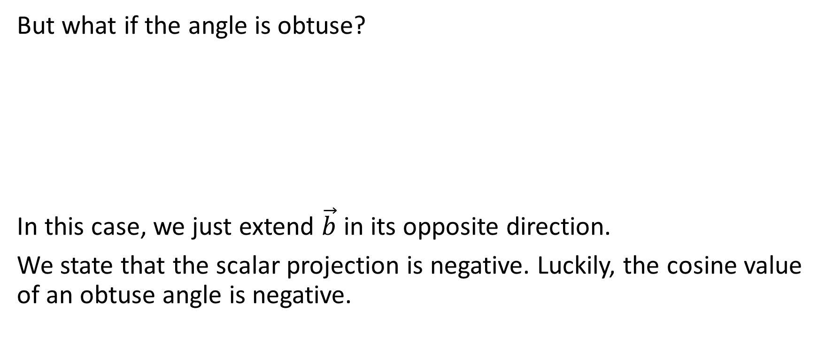
But what if the angle is obtuse?
In this case, we just extend $\vec{b}$ in its opposite direction.
We state that the scalar projection is negative. Luckily, the cosine value of an obtuse angle is negative.
$$\vec{a}$$
$$\vec{b}$$

Slide 14




But what if the angle is obtuse?
In this case, we just extend $\vec{b}$ in its opposite direction.
We state that the scalar projection is negative. Luckily, the cosine value of an obtuse angle is negative.
$$\vec{a}$$
$$\vec{b}$$

Slide 15
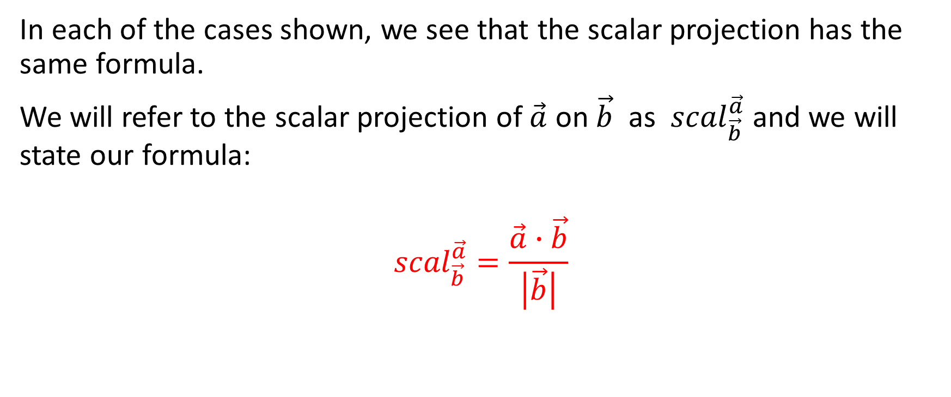
In each of the cases shown, we see that the scalar projection has the same formula.
We will refer to the scalar projection of $\vec{a}$ on $\vec{b}$ as ${scal}_{\vec{b}}^{\vec{a}}$ and we will state our formula:
$${scal}_{\vec{b}}^{\vec{a}}=\frac{\vec{a}∙\vec{b}}{\left|\vec{b}\right|}$$

Slide 16
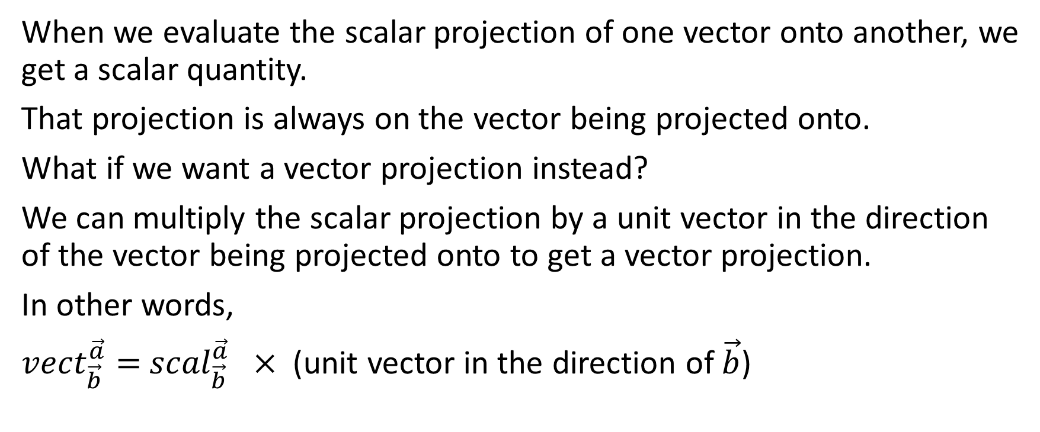
Part 2: Vector Projections
When we evaluate the scalar projection of one vector onto another, we get a scalar quantity.
That projection is always on the vector being projected onto.
What if we want a vector projection instead?
We can multiply the scalar projection by a unit vector in the direction of the vector being projected onto to get a vector projection.
In other words,
${vect}_{\vec{b}}^{\vec{a}}=$ ${scal}_{\vec{b}}^{\vec{a}} ×$(unit vector in the direction of $\vec{b}$)

Slide 17

${vect}_{\vec{b}}^{\vec{a}}=$ ${scal}_{\vec{b}}^{\vec{a}} ×$(unit vector in the direction of $\vec{b}$)

Slide 18
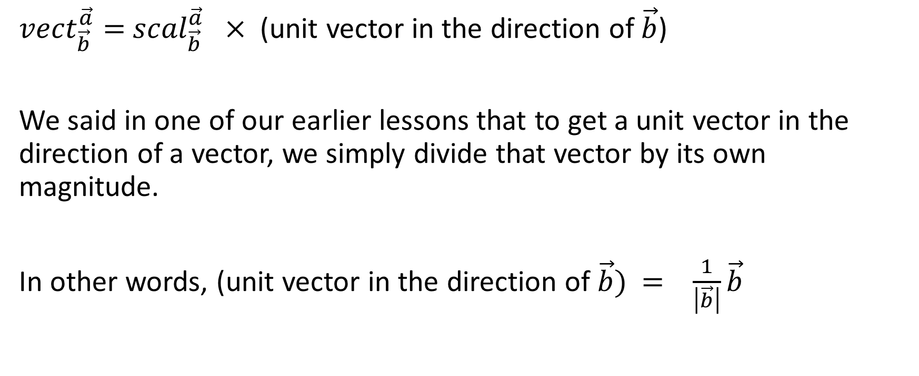
${vect}_{\vec{b}}^{\vec{a}}=$ ${scal}_{\vec{b}}^{\vec{a}} ×$(unit vector in the direction of $\vec{b}$)
We said in one of our earlier lessons that to get a unit vector in the direction of a vector, we simply divide that vector by its own magnitude.
In other words, (unit vector in the direction of $\vec{b})$ $= \frac{1}{\left|\vec{b}\right|}\vec{b}$

Slide 19
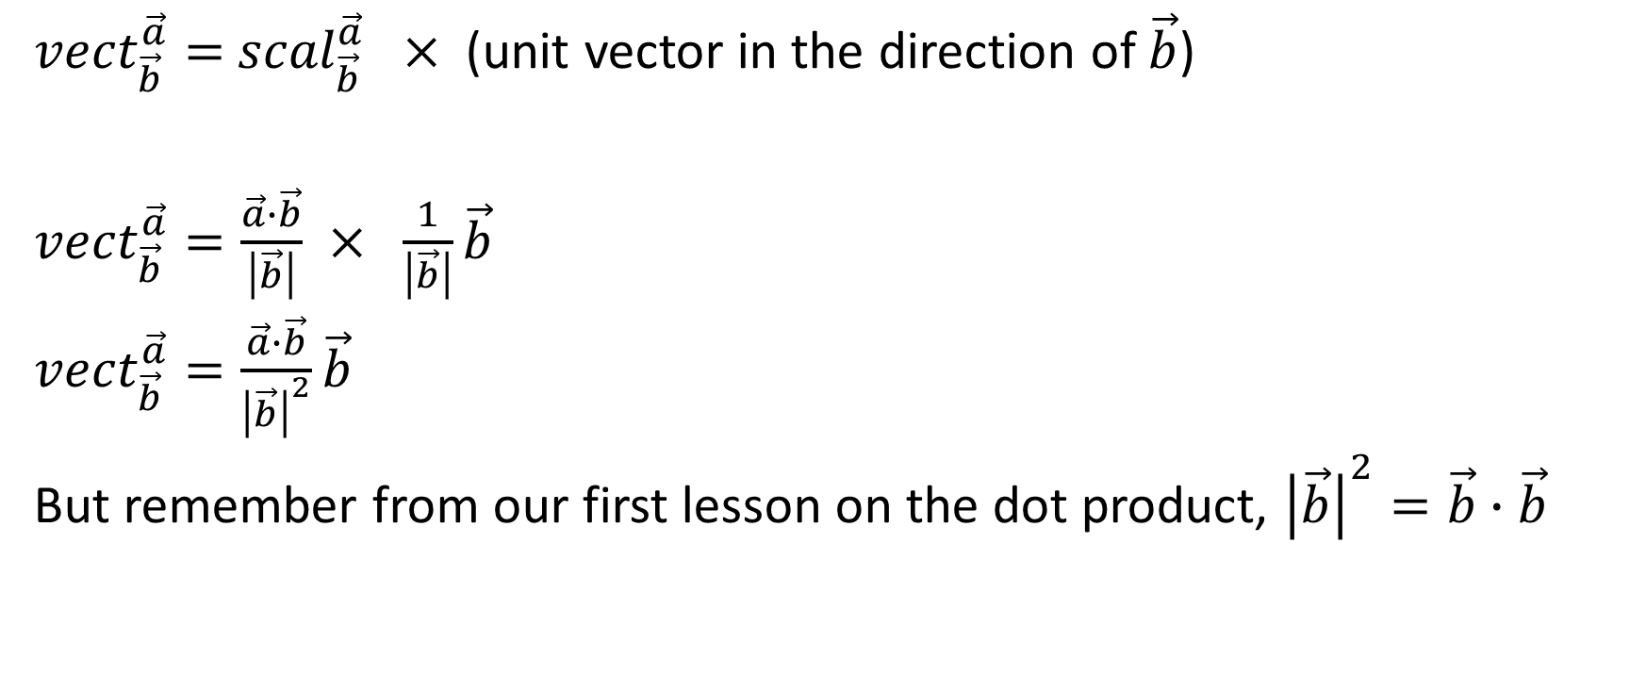
${vect}_{\vec{b}}^{\vec{a}}=$ ${scal}_{\vec{b}}^{\vec{a}} ×$(unit vector in the direction of $\vec{b}$)
${vect}_{\vec{b}}^{\vec{a}}=\frac{\vec{a}∙\vec{b}}{\left|\vec{b}\right|} × \frac{1}{\left|\vec{b}\right|}\vec{b}$
${vect}_{\vec{b}}^{\vec{a}}=\frac{\vec{a}∙\vec{b}}{{\left|\vec{b}\right|}^{2}}\vec{b}$
But remember from our first lesson on the dot product, ${\left|\vec{b}\right|}^{2}=\vec{b}∙\vec{b}$

Slide 20
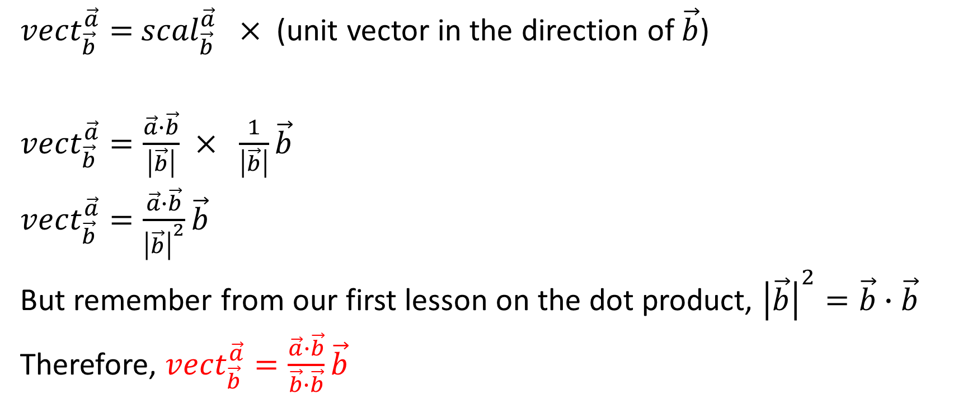
${vect}_{\vec{b}}^{\vec{a}}=$ ${scal}_{\vec{b}}^{\vec{a}} ×$(unit vector in the direction of $\vec{b}$)
${vect}_{\vec{b}}^{\vec{a}}=\frac{\vec{a}∙\vec{b}}{\left|\vec{b}\right|} × \frac{1}{\left|\vec{b}\right|}\vec{b}$
${vect}_{\vec{b}}^{\vec{a}}=\frac{\vec{a}∙\vec{b}}{{\left|\vec{b}\right|}^{2}}\vec{b}$
But remember from our first lesson on the dot product, ${\left|\vec{b}\right|}^{2}=\vec{b}∙\vec{b}$
Therefore, ${vect}_{\vec{b}}^{\vec{a}}=\frac{\vec{a}∙\vec{b}}{\vec{b}∙\vec{b}}\vec{b}$

Slide 21

Example:
Given the vectors $\vec{a}=\vec{(−3,4,5\sqrt{3})}$ and $\vec{b}=\vec{(−2,2,−1)}$, determine the scalar and vector projections of $\vec{a}$ on $\vec{b}$ and of $\vec{b}$ on $\vec{a}$

Slide 22
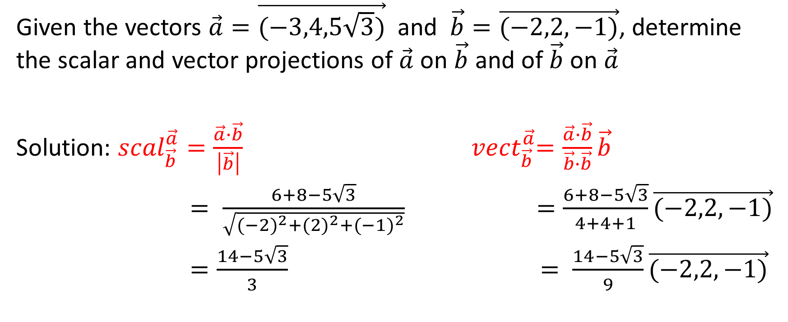
Given the vectors $\vec{a}=\vec{(−3,4,5\sqrt{3})}$ and $\vec{b}=\vec{(−2,2,−1)}$, determine the scalar and vector projections of $\vec{a}$ on $\vec{b}$ and of $\vec{b}$ on $\vec{a}$
Solution: ${scal}_{\vec{b}}^{\vec{a}}=\frac{\vec{a}∙\vec{b}}{\left|\vec{b}\right|}$ ${ vect}_{\vec{b}}^{\vec{a}}=\frac{\vec{a}∙\vec{b}}{\vec{b}∙\vec{b}}\vec{b}$
$= \frac{6+8−5\sqrt{3}}{\sqrt{{(−2)}^{2}+{(2)}^{2}+{(−1)}^{2}}}$ $=\frac{6+8−5\sqrt{3}}{4+4+1}\vec{(−2,2,−1)}$
$=\frac{14−5\sqrt{3}}{3}$ $= \frac{14−5\sqrt{3}}{9}\vec{(−2,2,−1)}$

Slide 23
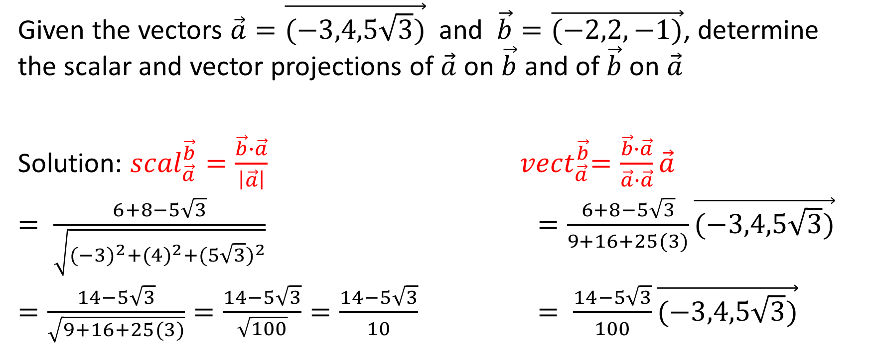
Given the vectors $\vec{a}=\vec{(−3,4,5\sqrt{3})}$ and $\vec{b}=\vec{(−2,2,−1)}$, determine the scalar and vector projections of $\vec{a}$ on $\vec{b}$ and of $\vec{b}$ on $\vec{a}$
Solution: ${scal}_{\vec{a}}^{\vec{b}}=\frac{\vec{b}∙\vec{a}}{\left|\vec{a}\right|}$ ${ vect}_{\vec{a}}^{\vec{b}}=\frac{\vec{b}∙\vec{a}}{\vec{a}∙\vec{a}}\vec{a}$
$= \frac{6+8−5\sqrt{3}}{\sqrt{{(−3)}^{2}+{(4)}^{2}+{(5\sqrt{3})}^{2}}}$ $=\frac{6+8−5\sqrt{3}}{9+16+25(3)}\vec{(−3,4,5\sqrt{3})}$
$=\frac{14−5\sqrt{3}}{\sqrt{9+16+25(3)}}=\frac{14−5\sqrt{3}}{\sqrt{100}}=\frac{14−5\sqrt{3}}{10}$ $= \frac{14−5\sqrt{3}}{100}\vec{(−3,4,5\sqrt{3})}$

Slide 24

Determining Projections onto an Axis
To determine the scalar and vector projections made by a vector with one of the positive axes, you simply need to determine the scalar or vector projection of that vector with the associated unit vector, either $\vec{i}$, $\vec{j}$ or $\vec{k}$.

Slide 25

Example: Determine the scalar projection of the vector $\vec{u}=\left(−3,7,4\right)$ on the vector $\vec{v}=\vec{(1,0,0)}$ and then on the vector $\vec{w}=\vec{(100,0,0)}$.

Slide 26
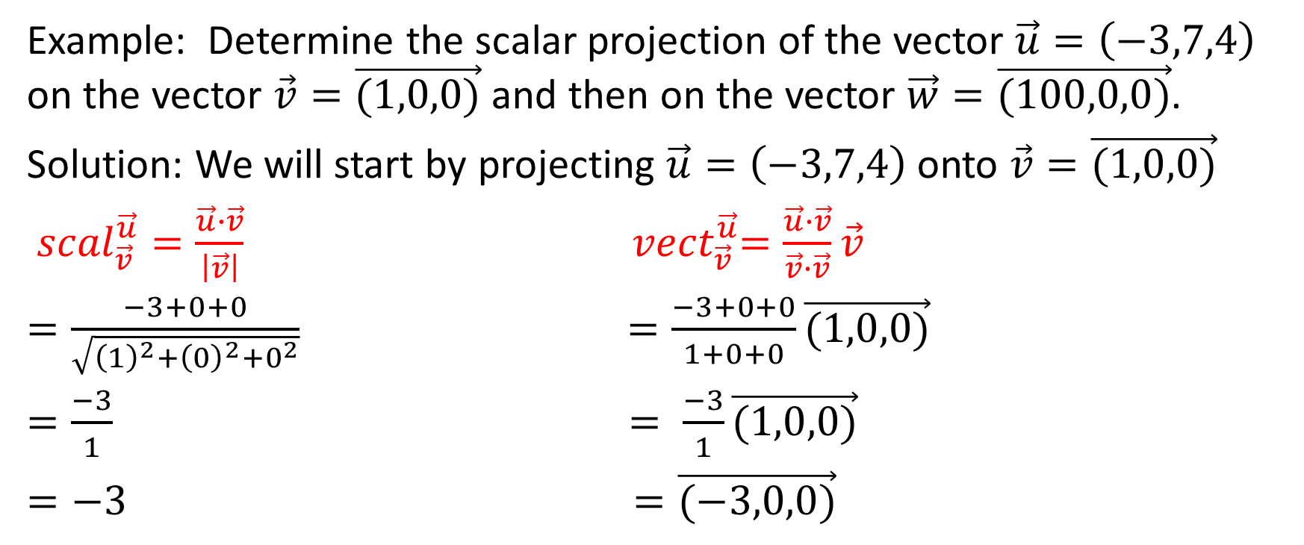
Example: Determine the scalar projection of the vector $\vec{u}=\left(−3,7,4\right)$ on the vector $\vec{v}=\vec{(1,0,0)}$ and then on the vector $\vec{w}=\vec{(100,0,0)}$.
Solution: We will start by projecting $\vec{u}=\left(−3,7,4\right)$onto $\vec{v}=\vec{(1,0,0)}$
${scal}_{\vec{v}}^{\vec{u}}=\frac{\vec{u}∙\vec{v}}{\left|\vec{v}\right|}$ ${ vect}_{\vec{v}}^{\vec{u}}=\frac{\vec{u}∙\vec{v}}{\vec{v}∙\vec{v}}\vec{v}$
$=\frac{−3+0+0}{\sqrt{{\left(1\right)}^{2}+{\left(0\right)}^{2}+0^{2}}}$ $=\frac{−3+0+0}{1+0+0}\vec{(1,0,0)}$
$=\frac{−3}{1}$ $= \frac{−3}{1}\vec{(1,0,0)}$
$=−3$ $=\vec{(−3,0,0)}$

Slide 27

Example: Now, let’s determine the scalar and vector projections of $\vec{u}=\vec{(−3,7,4)}$ on $\vec{w}=\vec{(100,0,0)}$.

Slide 28
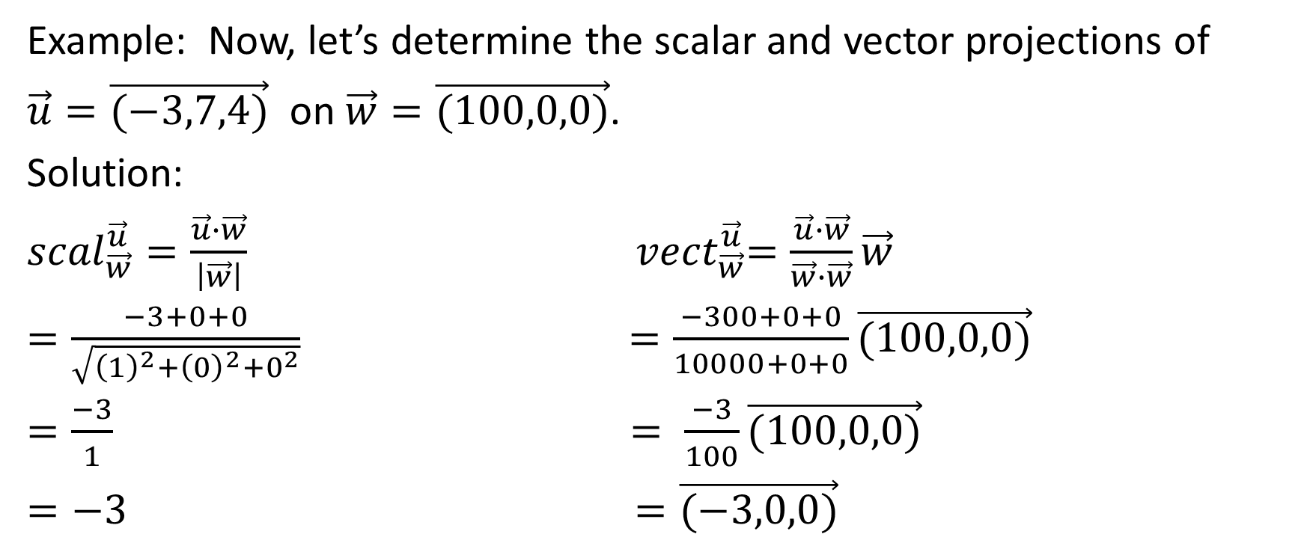
Example: Now, let’s determine the scalar and vector projections of
$\vec{u}=\vec{(−3,7,4)}$ on $\vec{w}=\vec{(100,0,0)}$.
Solution:
${scal}_{\vec{w}}^{\vec{u}}=\frac{\vec{u}∙\vec{w}}{\left|\vec{w}\right|}$ ${ vect}_{\vec{w}}^{\vec{u}}=\frac{\vec{u}∙\vec{w}}{\vec{w}∙\vec{w}}\vec{w}$
$=\frac{−3+0+0}{\sqrt{{\left(1\right)}^{2}+{\left(0\right)}^{2}+0^{2}}}$ $=\frac{−300+0+0}{10000+0+0}\vec{(100,0,0)}$
$=\frac{−3}{1}$ $= \frac{−3}{100}\vec{(100,0,0)}$
$=−3$ $=\vec{(−3,0,0)}$

Slide 29

The scalar and vector projections of the vector $\vec{u}$ are the same on the vector $\vec{(1,0,0)}$ as they are on the vector $\vec{(100,0,0)}$.
This makes sense

Slide 30

The scalar and vector projections of the vector $\vec{u}$ are the same on the vector $\vec{(1,0,0)}$ as they are on the vector $\vec{(100,0,0)}$.
This makes sense. Extend the floor on the first diagram.

Slide 31
The scalar and vector projections of the vector $\vec{u}$ are the same on the vector $\vec{(1,0,0)}$ as they are on the vector $\vec{(100,0,0)}$.
This makes sense. Extend the floor on the first diagram.

Slide 32
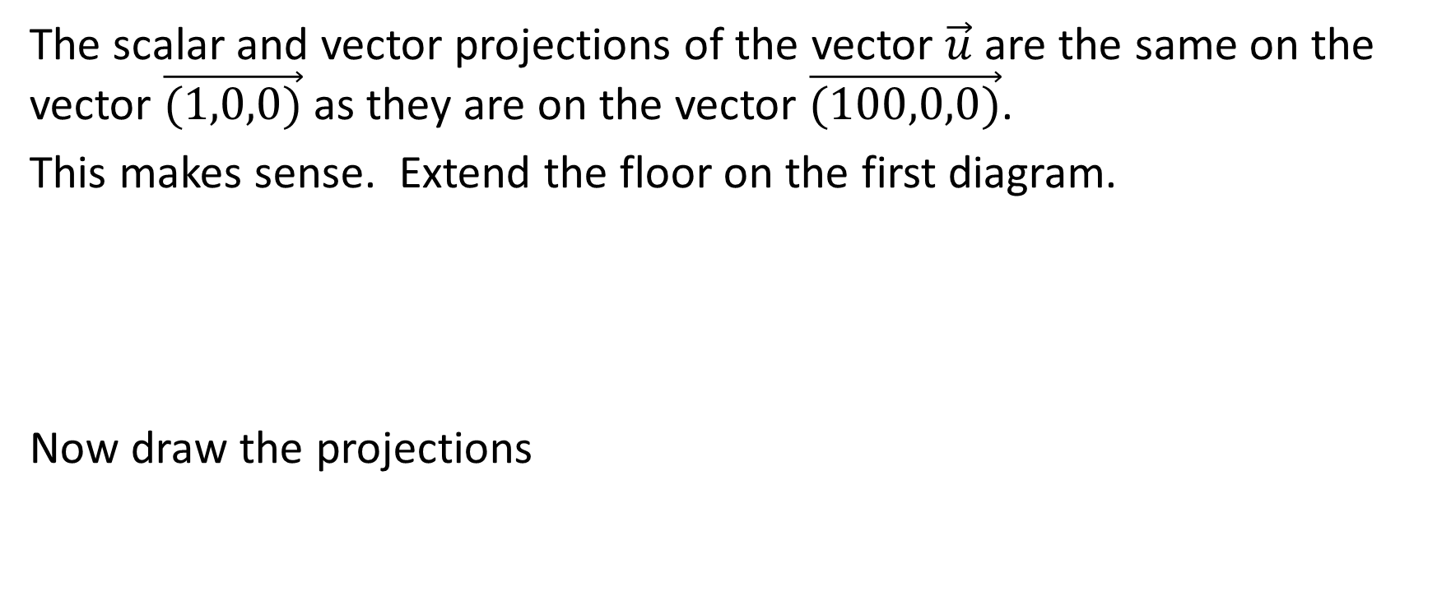
The scalar and vector projections of the vector $\vec{u}$ are the same on the vector $\vec{(1,0,0)}$ as they are on the vector $\vec{(100,0,0)}$.
This makes sense. Extend the floor on the first diagram.
Now draw the projections

Slide 33
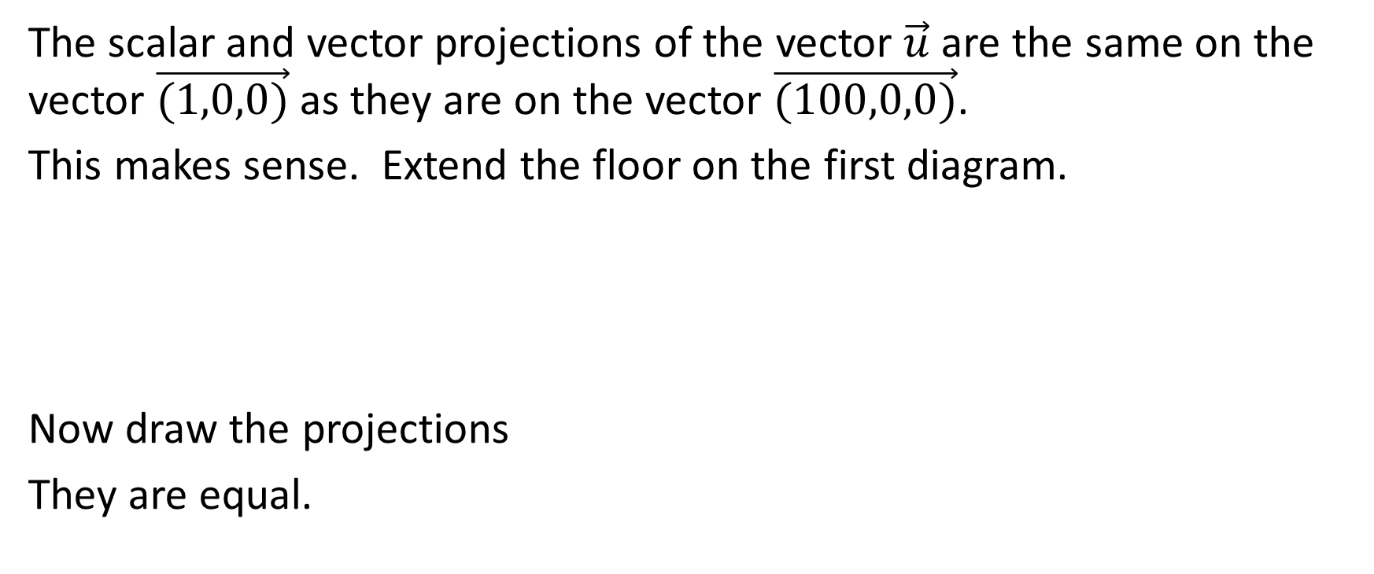
The scalar and vector projections of the vector $\vec{u}$ are the same on the vector $\vec{(1,0,0)}$ as they are on the vector $\vec{(100,0,0)}$.
This makes sense. Extend the floor on the first diagram.
Now draw the projections
They are equal.

Slide 34
So long as the vector being projected onto in the first diagram is in the same direction as the vector being projected onto in the second diagram, then the projection of a given vector onto the vector in the
first diagram will be the same as the projection of that given vector onto the vector in the second diagram.

Slide 35
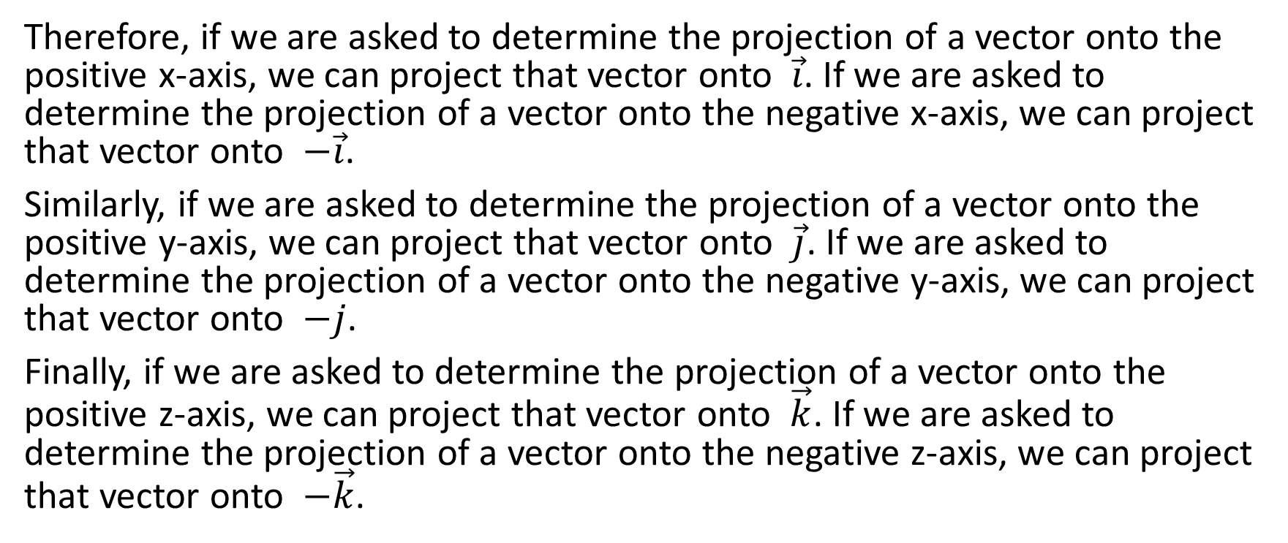
Therefore, if we are asked to determine the projection of a vector onto the positive x-axis, we can project that vector onto $\vec{i}$. If we are asked to determine the projection of a vector onto the negative x-axis, we can project that vector onto $−\vec{i}$.
Similarly, if we are asked to determine the projection of a vector onto the positive y-axis, we can project that vector onto $\vec{j}$. If we are asked to determine the projection of a vector onto the negative y-axis, we can project that vector onto $−j$.
Finally, if we are asked to determine the projection of a vector onto the positive z-axis, we can project that vector onto $\vec{k}$. If we are asked to determine the projection of a vector onto the negative z-axis, we can project that vector onto $−\vec{k}$.

Slide 36

Direction Cosines
Suppose I want to know the angle made by the vector $\vec{(a,b,c)}$with the positive x-axis

Slide 37




Direction Cosines
Suppose I want to know the angle made by the vector $\vec{(a,b,c)}$with the positive x-axis

Slide 38



Direction Cosines
Suppose I want to know the angle made by the vector $\vec{(a,b,c)}$with the positive x-axis

Slide 39

Direction Cosines
Suppose I want to know the angle made by the vector $\vec{(a,b,c)}$with the positive x-axis
There is a 90° angle and the vector is the hypotenuse.

Slide 40
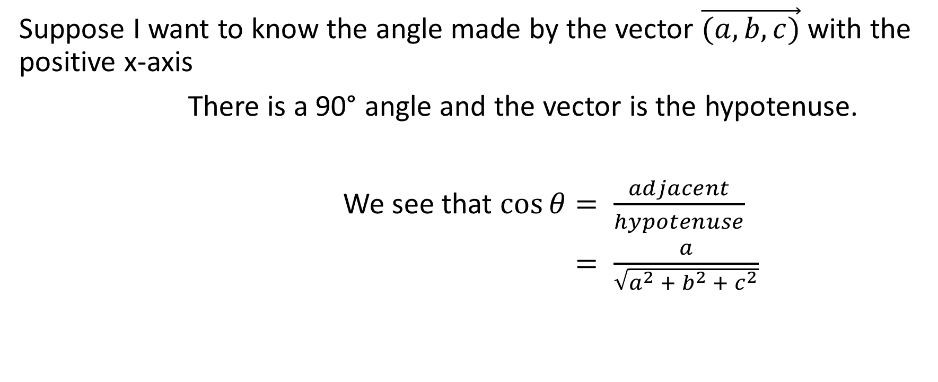
Direction Cosines
Suppose I want to know the angle made by the vector $\vec{(a,b,c)}$with the positive x-axis
There is a 90° angle and the vector is the hypotenuse.
We see that $\cos{θ}= \frac{adjacent}{hypotenuse}$
$= \frac{a}{\sqrt{a^{2} + b^{2} + c^{2}}}$

Slide 41
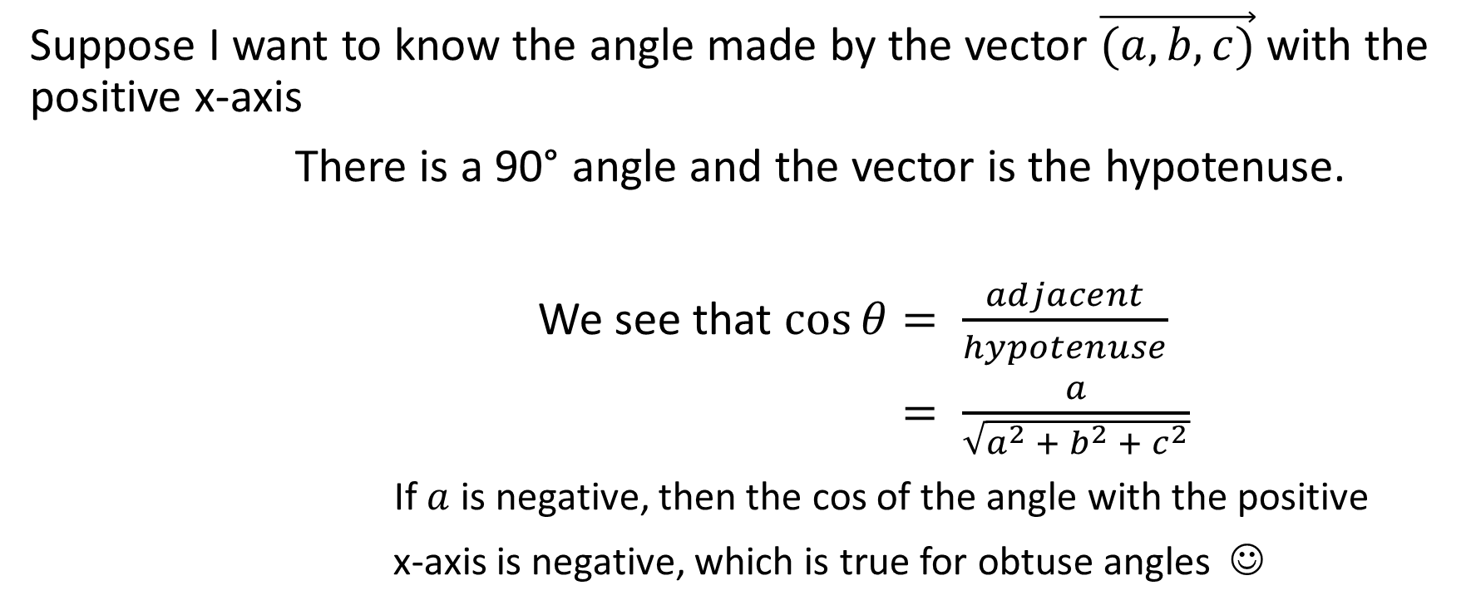
Direction Cosines
Suppose I want to know the angle made by the vector $\vec{(a,b,c)}$with the positive x-axis
There is a 90° angle and the vector is the hypotenuse.
We see that $\cos{θ}= \frac{adjacent}{hypotenuse}$
$= \frac{a}{\sqrt{a^{2} + b^{2} + c^{2}}}$
If $a$ is negative, then the cos of the angle with the positive
x-axis is negative, which is true for obtuse angles ☺

Slide 42
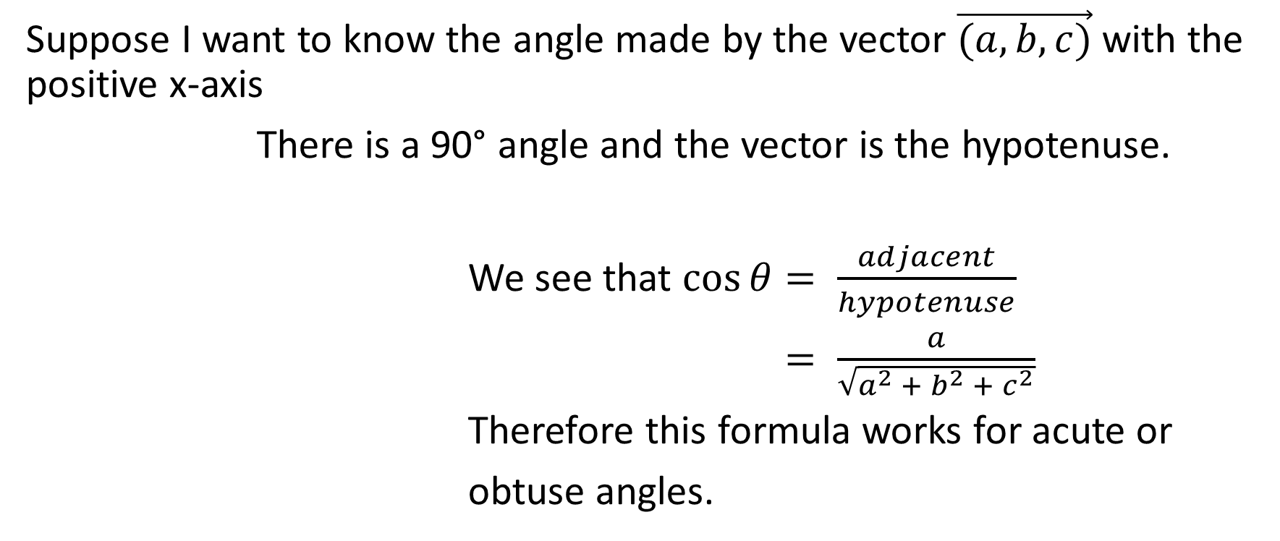
Direction Cosines
Suppose I want to know the angle made by the vector $\vec{(a,b,c)}$with the positive x-axis
There is a 90° angle and the vector is the hypotenuse.
We see that $\cos{θ}= \frac{adjacent}{hypotenuse}$
$= \frac{a}{\sqrt{a^{2} + b^{2} + c^{2}}}$
Therefore this formula works for acute or
obtuse angles.

Slide 43
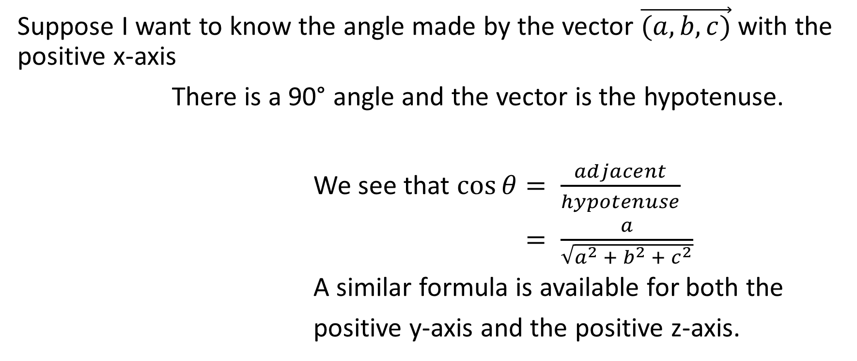
Direction Cosines
Suppose I want to know the angle made by the vector $\vec{(a,b,c)}$with the positive x-axis
There is a 90° angle and the vector is the hypotenuse.
We see that $\cos{θ}= \frac{adjacent}{hypotenuse}$
$= \frac{a}{\sqrt{a^{2} + b^{2} + c^{2}}}$
A similar formula is available for both the
positive y-axis and the positive z-axis.

Slide 44
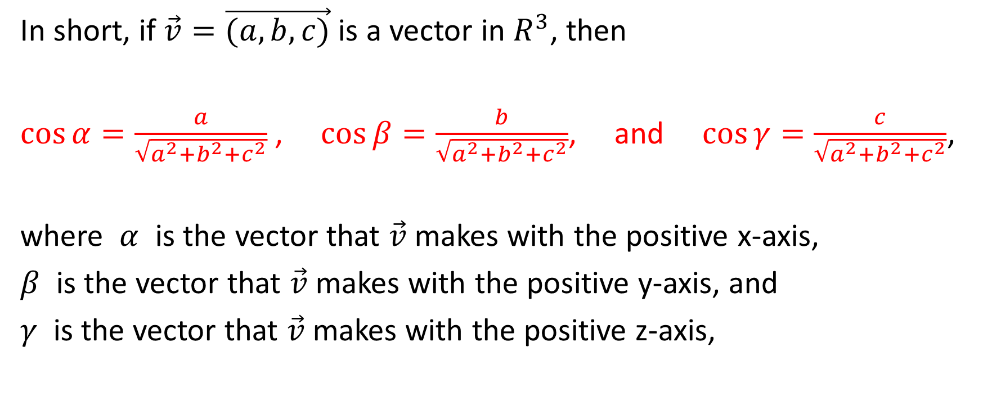
Direction Cosines
In short, if $\vec{v}=\vec{(a,b,c)}$ is a vector in $R^{3}$, then
$\cos{α=\frac{a}{\sqrt{a^{2}+b^{2}+c^{2}}}}$ , $\cos{β=\frac{b}{\sqrt{a^{2}+b^{2}+c^{2}}}}$, and $\cos{γ=\frac{c}{\sqrt{a^{2}+b^{2}+c^{2}}}}$,
where $α$ is the vector that $\vec{v}$ makes with the positive x-axis,
$β$ is the vector that $\vec{v}$ makes with the positive y-axis, and
$γ$ is the vector that $\vec{v}$ makes with the positive z-axis,

Slide 45

Example:
Determine the angle made by the vector $\vec{(−2,−6,3)}$ with each of the positive axes.

Slide 46
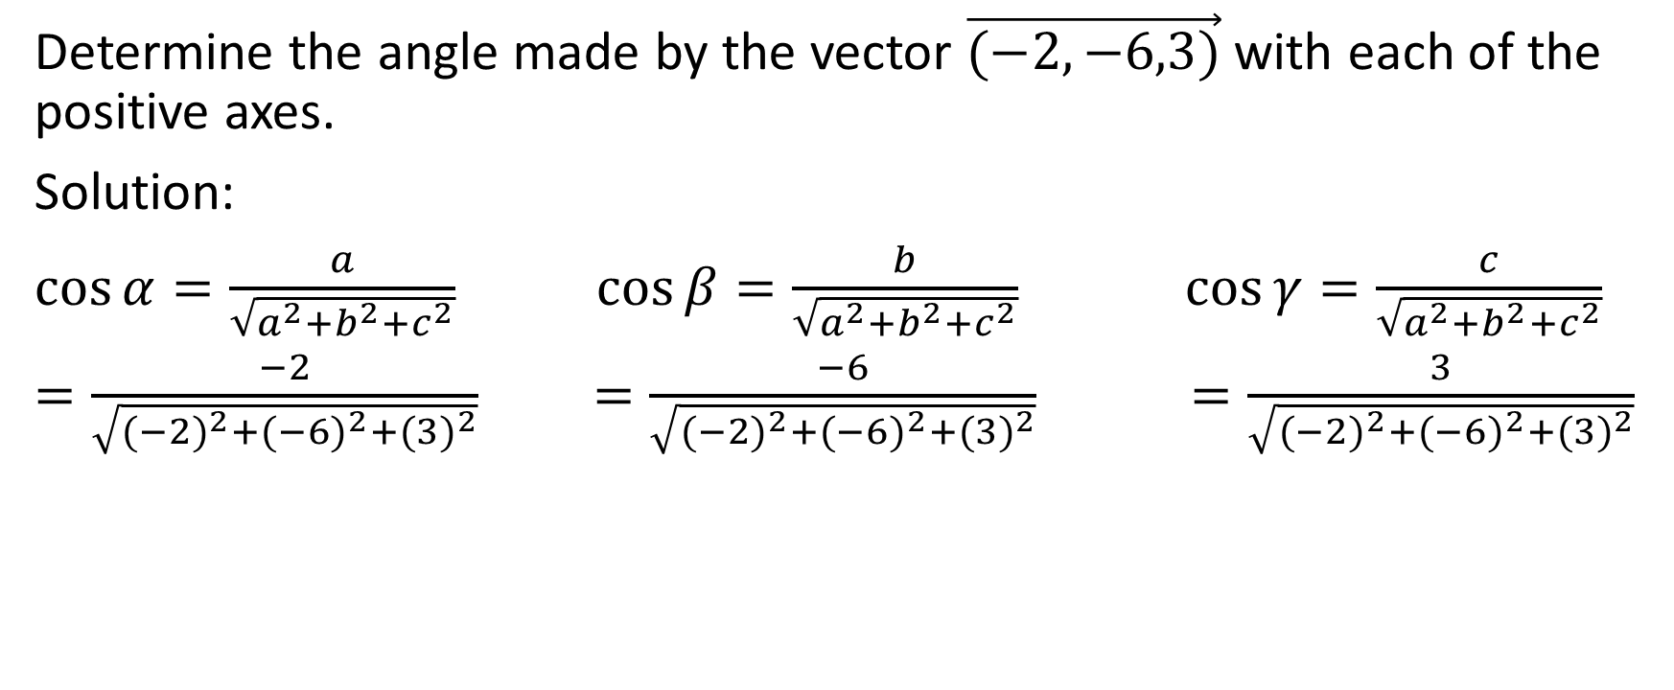
Example:
Determine the angle made by the vector $\vec{(−2,−6,3)}$ with each of the positive axes.
Solution:
$\cos{α=\frac{a}{\sqrt{a^{2}+b^{2}+c^{2}}}}$ $\cos{β=\frac{b}{\sqrt{a^{2}+b^{2}+c^{2}}}}$ $\cos{γ=\frac{c}{\sqrt{a^{2}+b^{2}+c^{2}}}}$
$=\frac{−2}{\sqrt{{(−2)}^{2}+{(−6)}^{2}+{(3)}^{2}}}$ $=\frac{−6}{\sqrt{{(−2)}^{2}+{(−6)}^{2}+{(3)}^{2}}}$ $=\frac{3}{\sqrt{{(−2)}^{2}+{(−6)}^{2}+{(3)}^{2}}}$

Slide 47
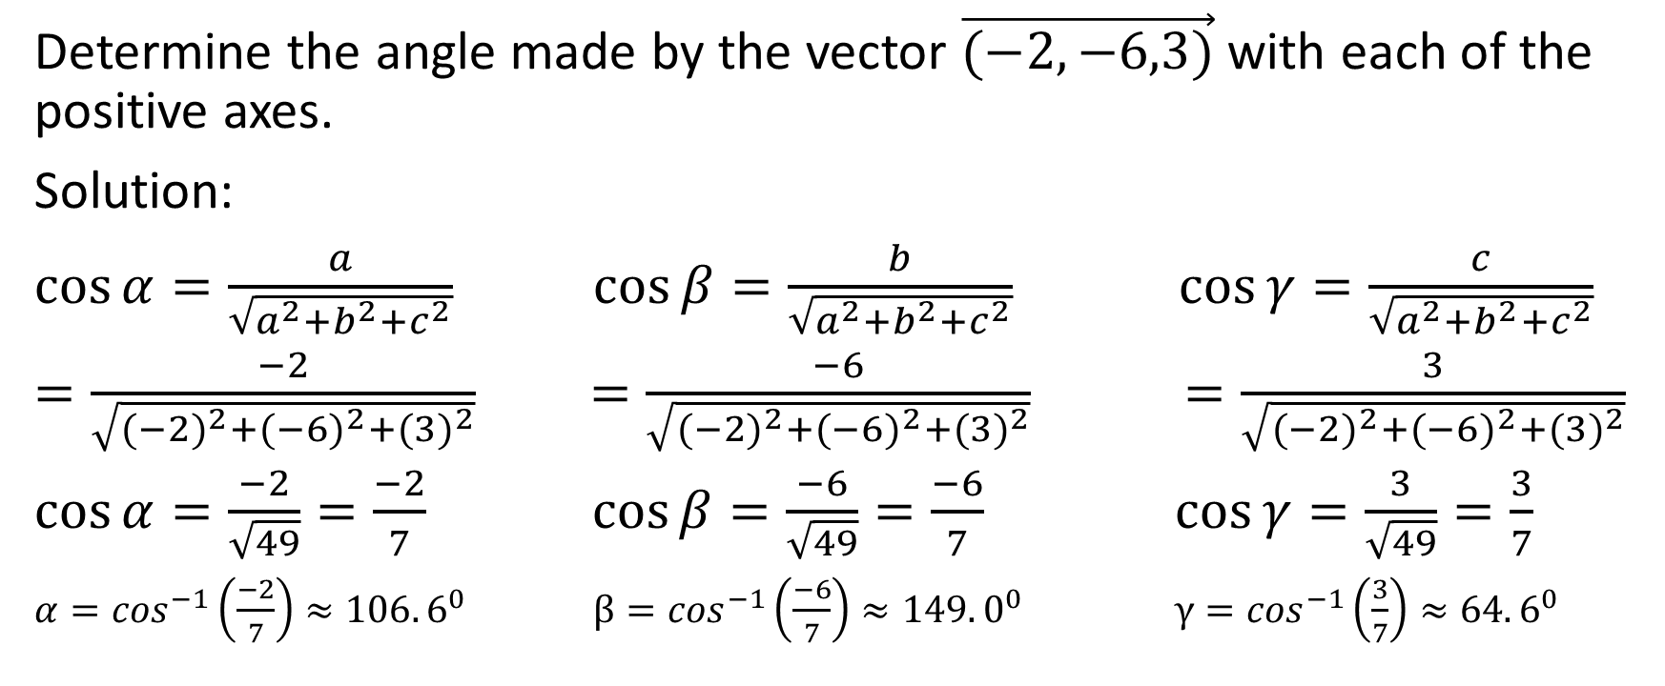
Example:
Determine the angle made by the vector $\vec{(−2,−6,3)}$ with each of the positive axes.
Solution:
$\cos{α=\frac{a}{\sqrt{a^{2}+b^{2}+c^{2}}}}$ $\cos{β=\frac{b}{\sqrt{a^{2}+b^{2}+c^{2}}}}$ $\cos{γ=\frac{c}{\sqrt{a^{2}+b^{2}+c^{2}}}}$
$=\frac{−2}{\sqrt{{(−2)}^{2}+{(−6)}^{2}+{(3)}^{2}}}$ $=\frac{−6}{\sqrt{{(−2)}^{2}+{(−6)}^{2}+{(3)}^{2}}}$ $=\frac{3}{\sqrt{{(−2)}^{2}+{(−6)}^{2}+{(3)}^{2}}}$
$\cos{α=\frac{−2}{\sqrt{49}}=\frac{−2}{7}}$ $\cos{β=\frac{−6}{\sqrt{49}}=\frac{−6}{7}}$ $\cos{γ=\frac{3}{\sqrt{49}}=\frac{3}{7}}$
$α=\cos^{−1}\left(\frac{−2}{7}\right)≈106.6^{0}$ $β=\cos^{−1}\left(\frac{−6}{7}\right)≈149.0^{0}$ $γ=\cos^{−1}\left(\frac{3}{7}\right)≈64.6^{0}$

Slide 48

Therefore the vector $\vec{(−2,−6,3)}$ makes an angle of approximately ${106.6}^{0}$ with the positive x-axis, an angle of approximately ${149.0}^{0}$ with the positive y-axis, and an angle of approximately ${64.6}^{0}$ with the positive z-axis.

